Slide 1
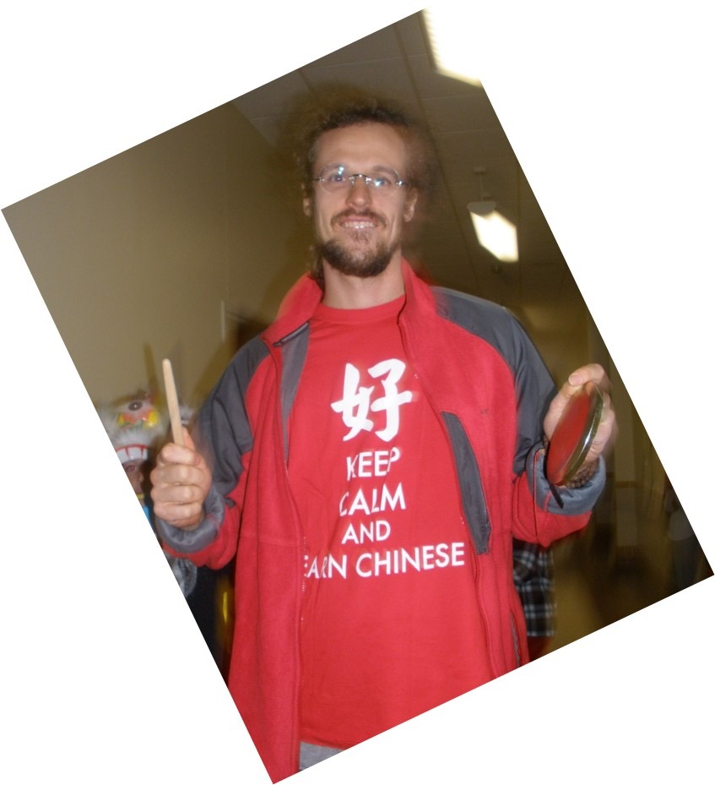
Sea Cliff FLES Mandarin
Instructor:
David Schultz
Certified Mandarin Teacher, Masters Degree in Teaching Chinese
As a Foreign Language from Peking University, Eight years of teaching and
Studying Chinese in Taiwan and China

Slide 2
Why Mandarin?
Mandarin stimulates different regions of the brain, fostering nuerological development, It activates the right-hemisphere of the brain which is not activated in speakers of English.
Mandarin makes you more musical – Tonal language!
1.5 billion Mandarin Speakers in the world
China’s growing clout in all domains of the Global Marketplace.
SVO’s, the Information age, and Mandarin

Slide 3
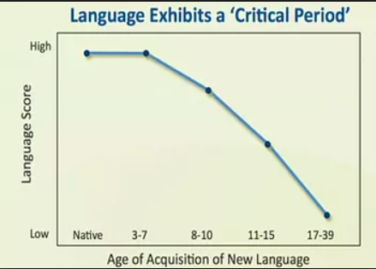
Why in Elementary School?
And to get a head start!

Slide 4
Goals of Program
Produce life-long learners of Mandarin and world languages
Promote Communicative Proficiency
  ACFTL Proficiency Guidelines Novice Mid to High
Introduce the 3P’s of Culture:
  Perspectives, practices, products
Orientate students to the defining features of the Mandarin Chinese language
  Chinese characters
  Tones

Slide 5
How to Reach those Goals
Care, build relationship and self esteem
  Whole-Child learning philosophy
Hands-on,engaging activities
Direct instruction and Context rich in Language input
Opportunities for interpersonal communication practice
Multi-media
Technology
Humour
Music and Art
Tai Chi Club, Mandarin after-sc
Homework

Slide 6
Problems
Difficulty of Mandarin
Lack of time = lack of proficiency
“foreign”language and culture – lack of connection between classroom and home, community
Lack of “linguistic talent”

Slide 7
Solving these Problems together
Advocate for program,resources and time!
Make language learning fun,promote productive struggle
Use resources (newsletters, websites, online resources)
Learn with child! (Duolingo, Chinesepod.com)
Community cultural activities, Chinatown
Emphasize the different aspects of Chinese learning

Slide 8
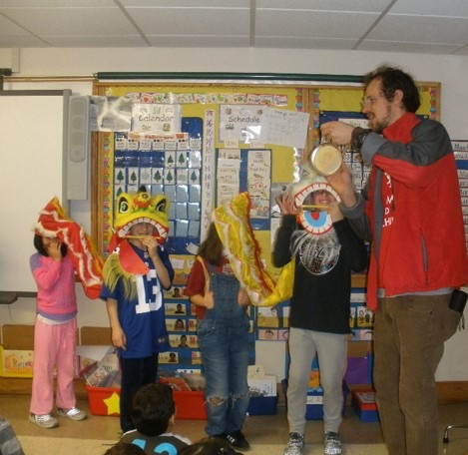
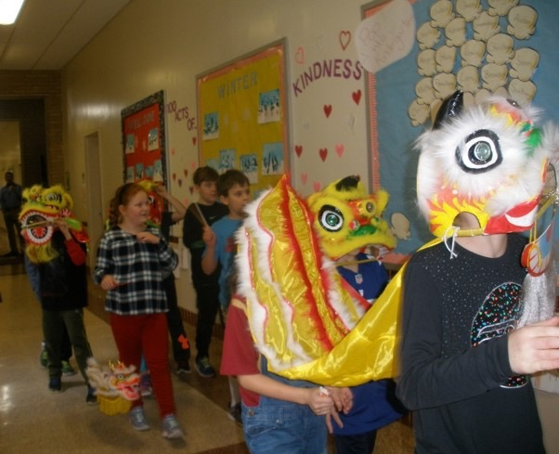
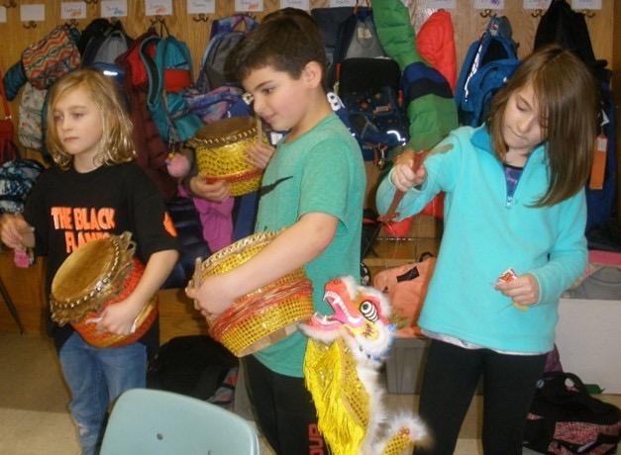
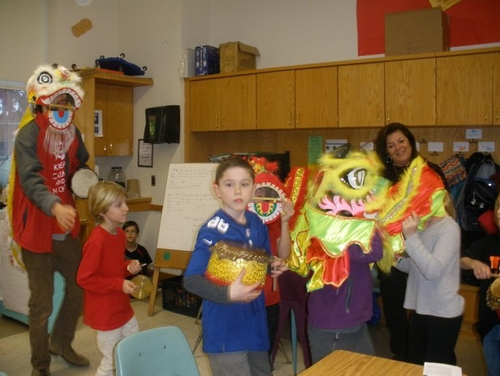
Language
Culture

Slide 9
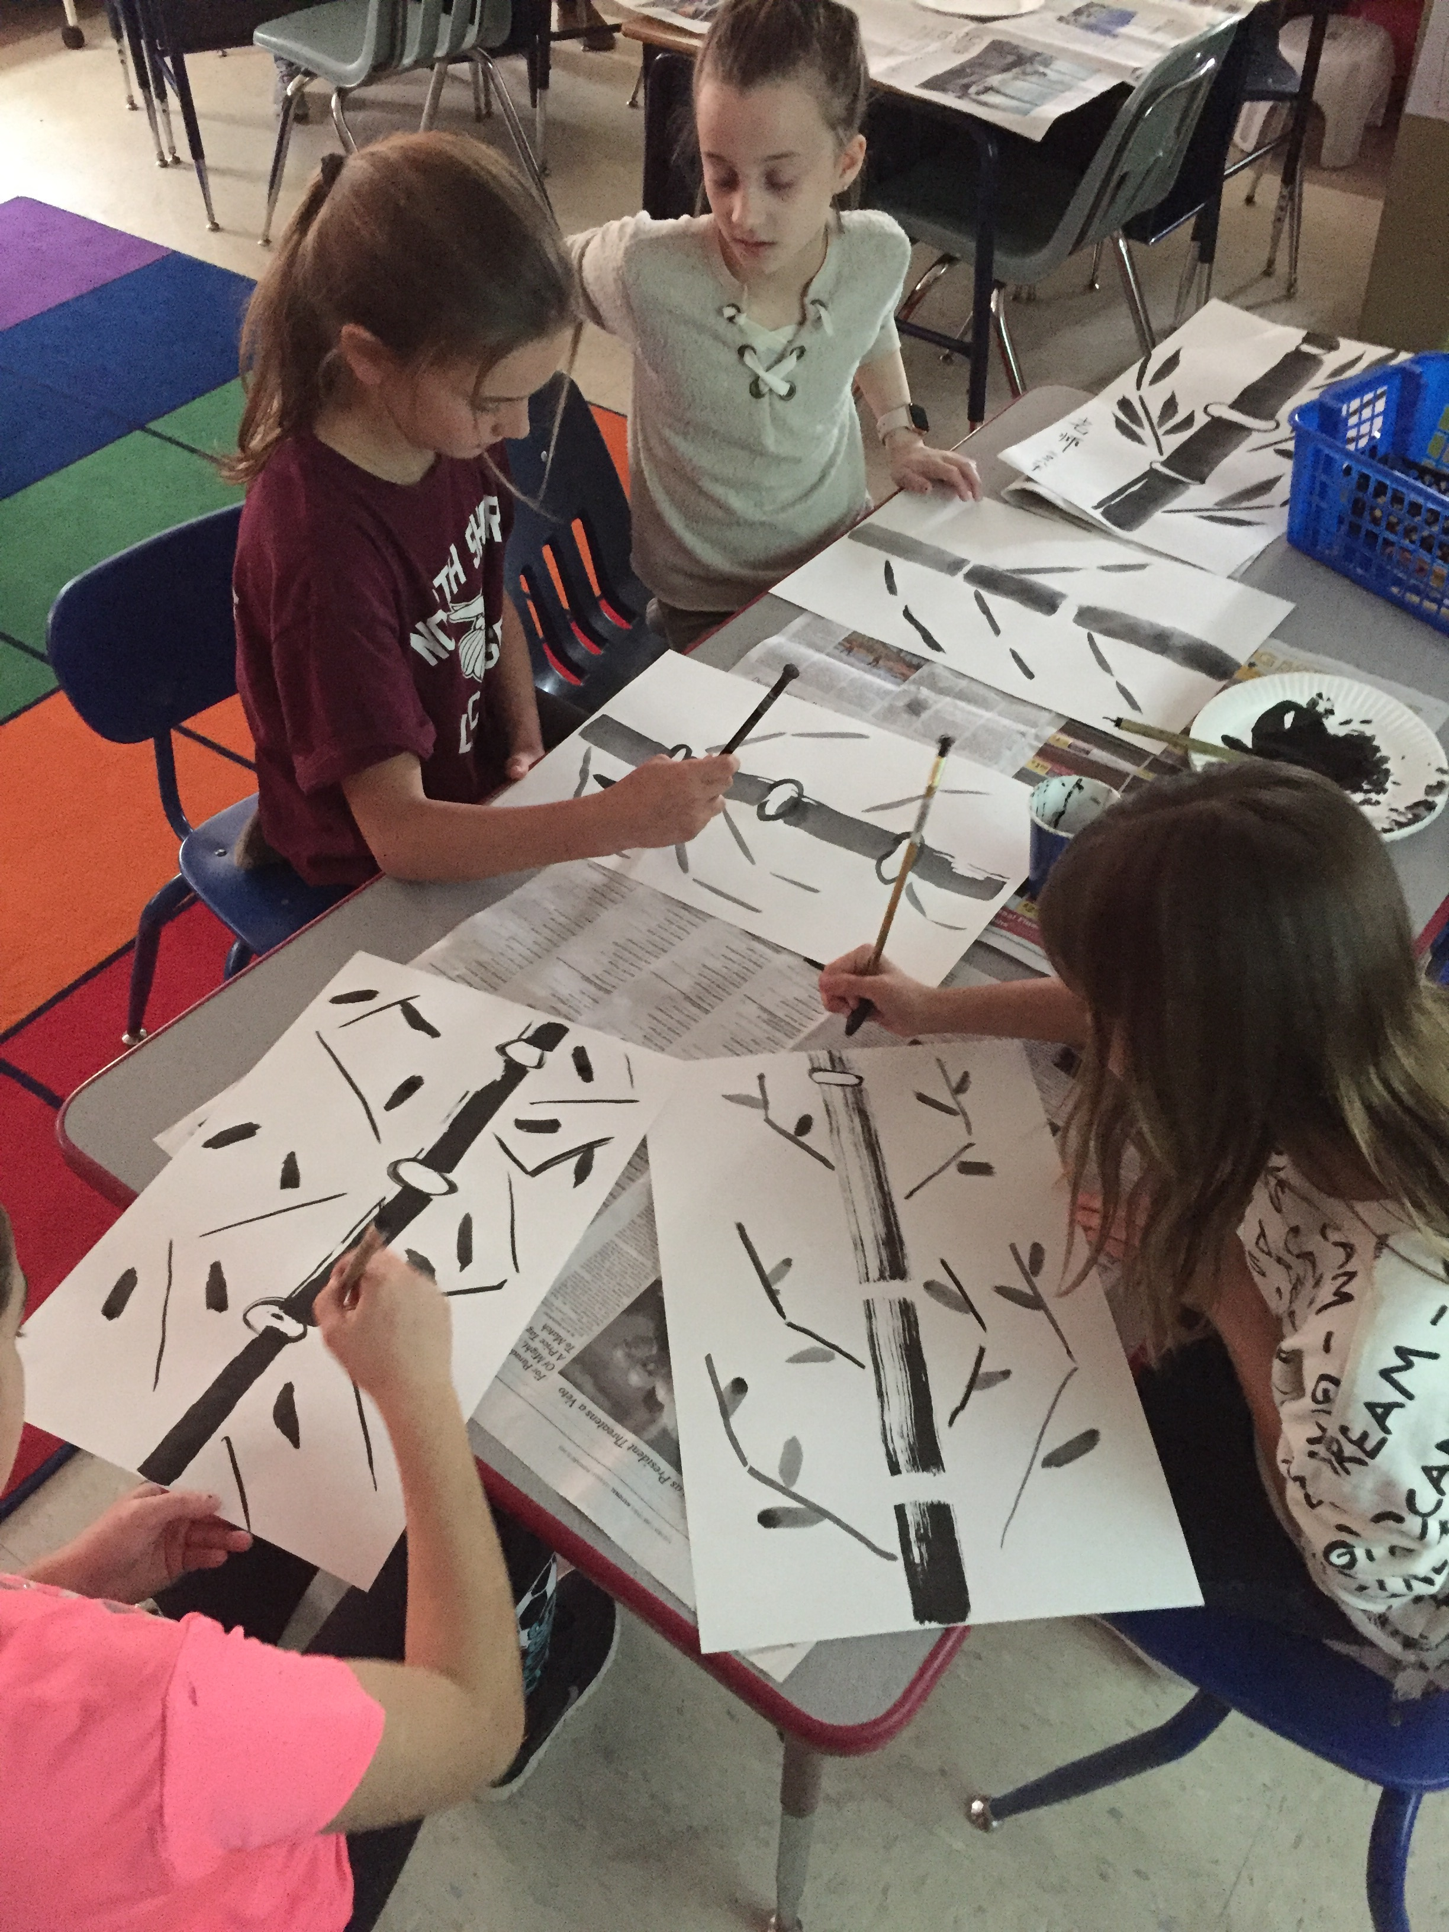
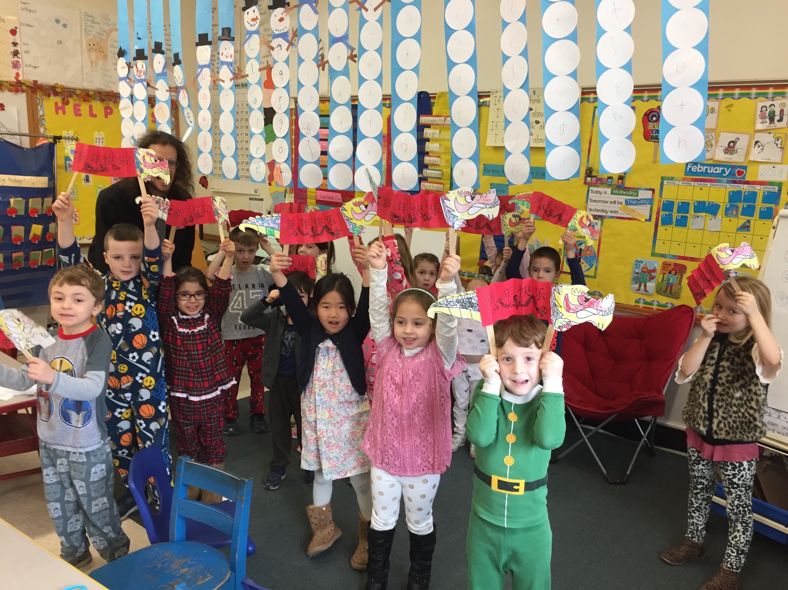
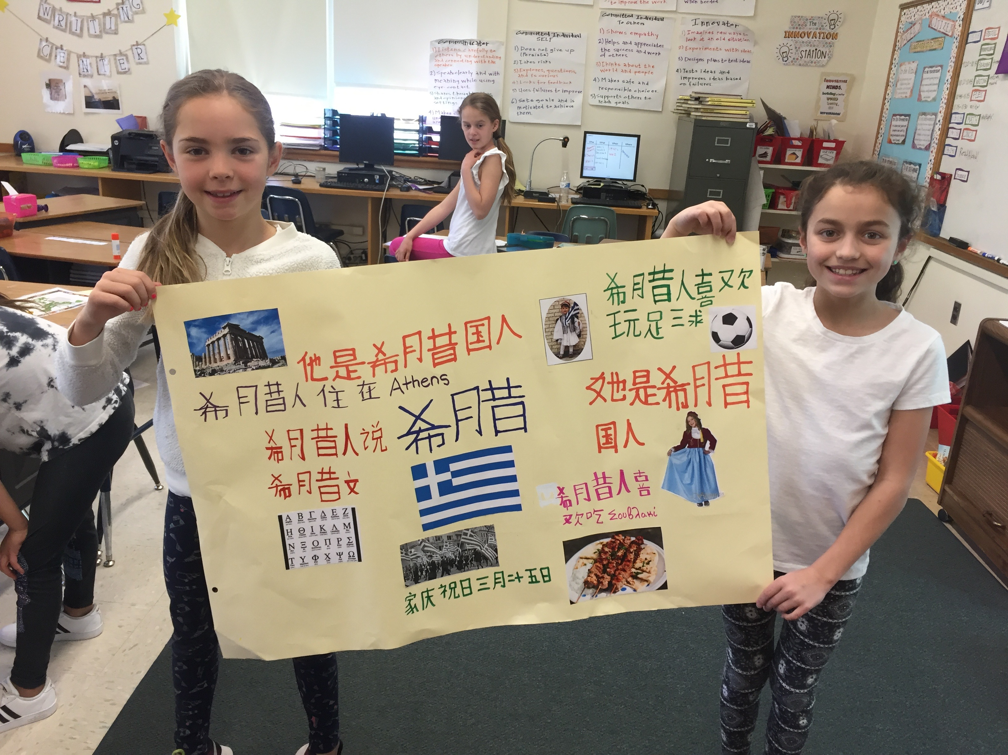
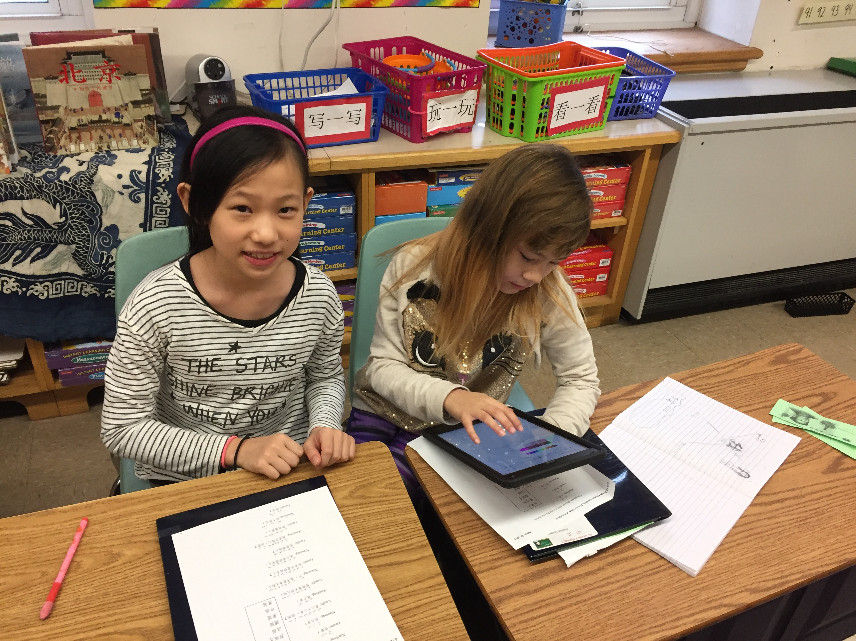
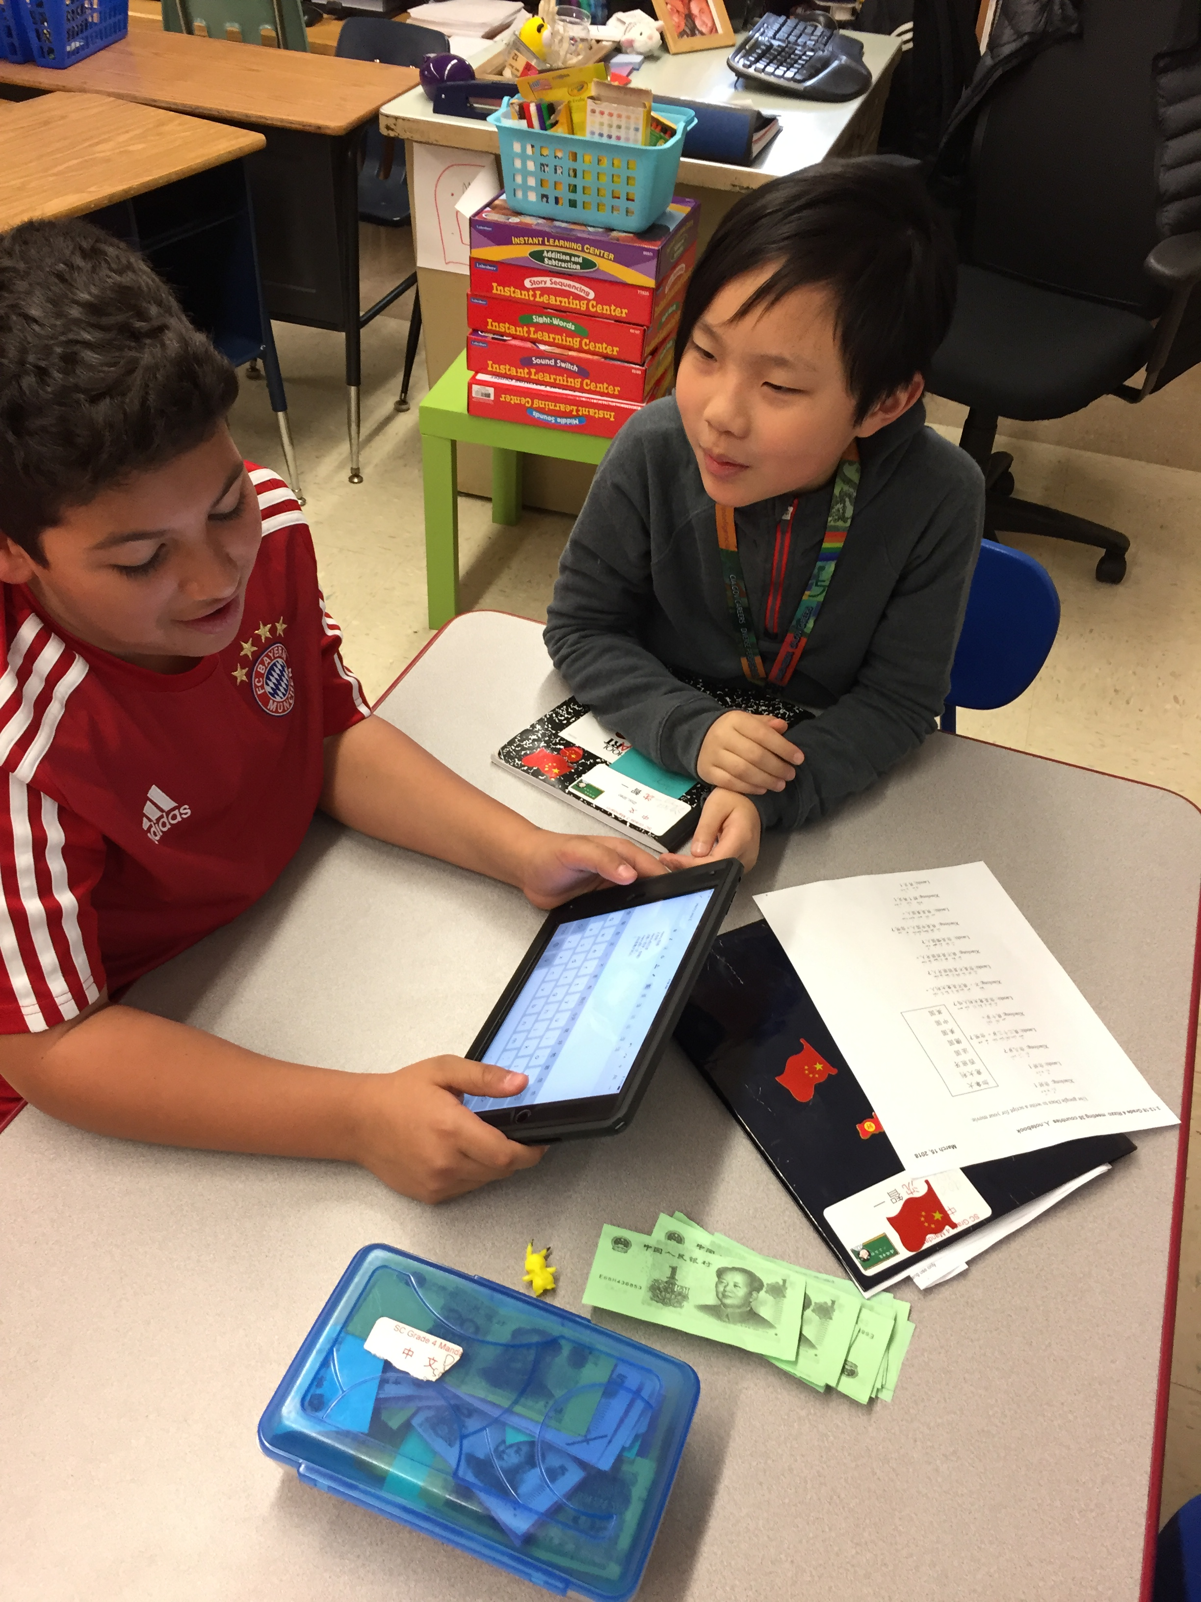
technology
Project based
Hands on
fun

Slide 10
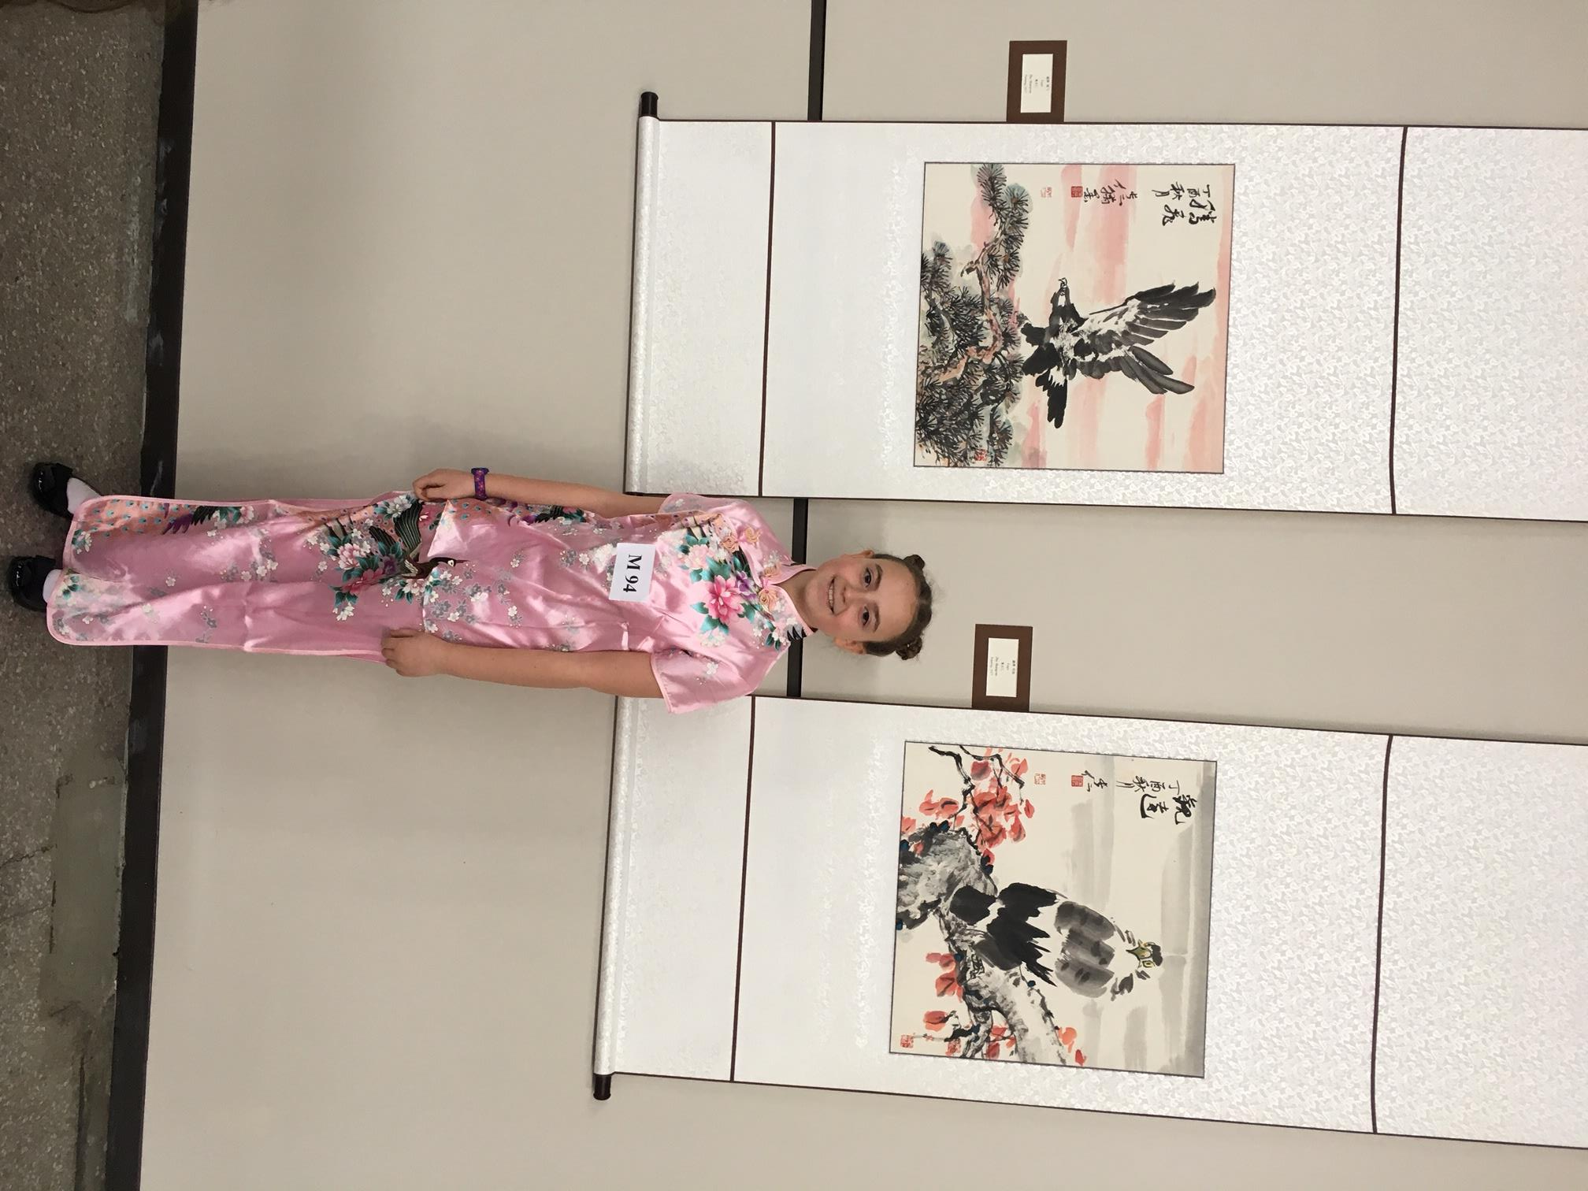
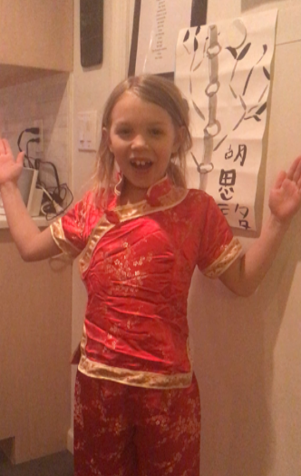
Lifelong Learners!

